Slide 1



AI Master Class series – Day 20
Drowsiness Detection

Slide 2
Day-20 Agenda.
01.
02.
03.
Drowsiness Detection
68-Landmark predictor
Workflow
04.
05.
Real-time Drowsiness detection
Q & A
Drowsiness detection &
Applications
Dlib library
Drowsiness detection process

Slide 3
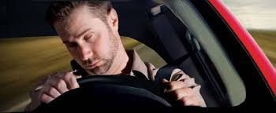
Drowsiness Detection.
Drowsiness refers to feeling abnormally sleepy during the day. People who are drowsy may fall asleep in inappropriate situations or at inappropriate times.
Driver drowsiness detection is a car safety technology which helps prevent accidents caused by the driver getting drowsy. Various studies have suggested that around 20% of all road accidents are fatigue-related, up to 50% on certain roads.

Slide 4
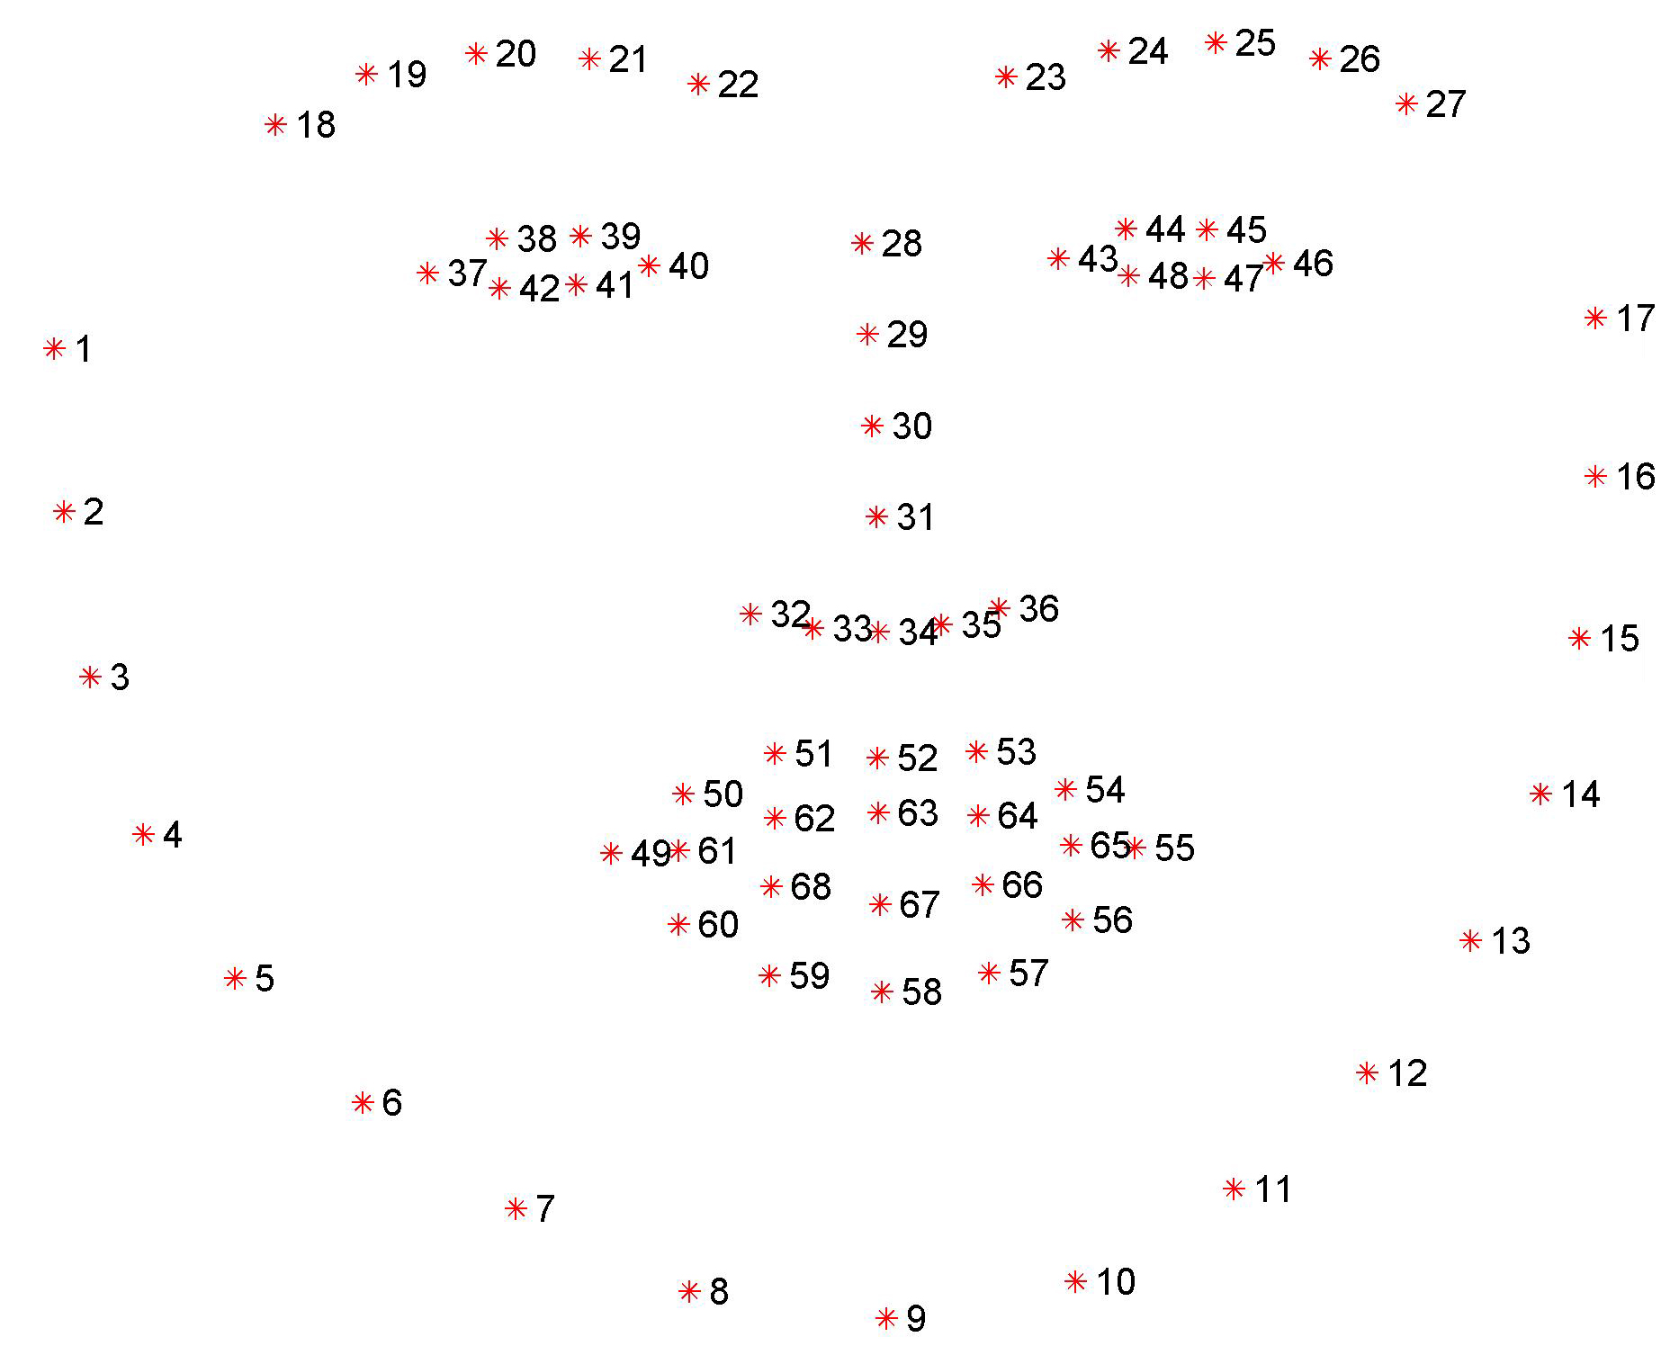
dlib’s facial landmark detector.
The pre-trained facial landmark detector inside the dlib library is used to estimate the location of 68 (x, y)-coordinates that map to facial structures on the face.
Facial landmarks are used for localizing and representing salient regions or facial parts of the person’s face, such as:
Nose
Jaws
Left eye
Right eye
Left eyebrow
Mouth
Right eyebrow

Slide 5
dlib’s facial landmark detector.
The Locations of the Facial Parts are as follows:
The left eye is accessed with points [42, 47].
The mouth is accessed through points [48, 67].
The left eyebrow is accessed through points [22, 26].
The nose is accessed using points [27, 34].
The right eyebrow is accessed through points [17, 21].
The right eye is accessed using points [36, 41].
And the jaw is accessed via points [0, 16].

Slide 6
Workflow of Drowsiness Detection.
Loading Face Detector & Landmark Predictor
Reading Frame from camera
Converting frame from BGR to Gray
Detecting Face
Identifying Left & Right eye Coordinate
Finding Eye Aspect Ratio
Eye close detection

Slide 7

! PRACTICAL SESSION !
Drowsiness Detection

Slide 8
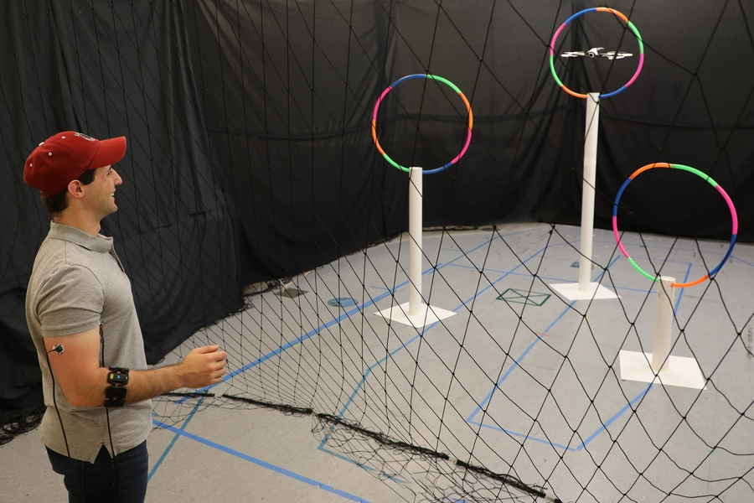
AI News – Day 20. April - 2020
CSAIL's Conduct-A-Bot system uses muscle signals to cue a drone’s movement, enabling more natural human-robot communication.

Slide 9
Thanks!
Tomorrow session
Do you have any questions?
sanjay@pantechmail.com
www.pantechsolutions.net
Road Sign Recognition

